Slide 1
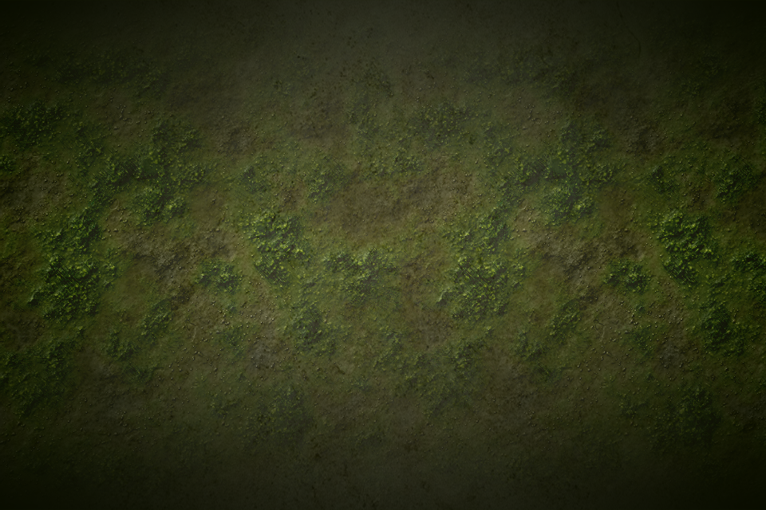
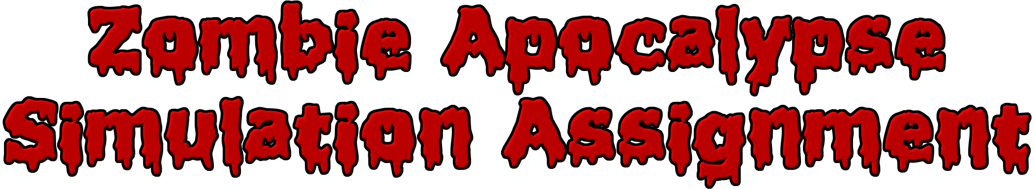

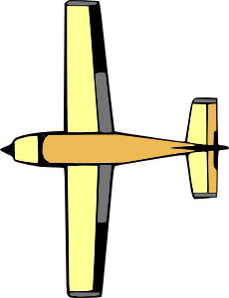


Slide 2

Scout- The Scout will wander around the map and collect supplies to bring back to the base. The two types of supplies are weapons and food. It will prioritize food when the population is greater than food available. Otherwise it will go for weapons.
Soldier- The solider will be spawned to the screen whenever there are weapons available at the base. The soldiers will wander around the map searching for zombies, and will shoot to kill. If they fail they will be converted or eaten.
Zombie- The zombie will wander around the map, however when it encounters a human, it will chase after it. It will then attack the human once it catches up. Based on its hunger level it will choose to either eat the human or convert it into a zombie.

Slide 3

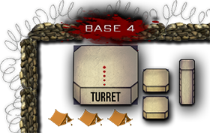
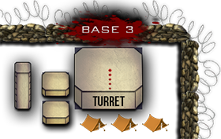
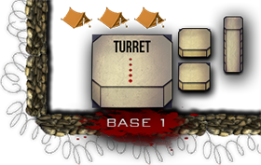
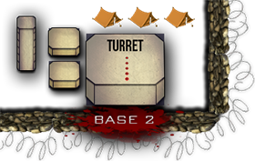

Base- The base class is an intricate system of code necessary to control the simulation. It determines when to spawn soldiers or scouts, has turrets which fire at zombies, contains four different base ID’s to inform soldiers and scouts where to return to, and lastly contains the population number of each base to determine whether to get food or to get weapons.
Supplies- The Supply crates contain either food or weapons. When a scout of any base approaches it, it will pick up what is inside. Scouts will still only go for what their base requires though.
Obstacles- The obstacles simply create path blocks for all characters. This way it is harder for zombies to convert humans, and harder for soldiers and scouts to do what they need to.

Slide 4

Pizza Icon- This is used to represent when a scout is carrying food back to the base. These icons will follow the instance of scout they are paired with. Useful class to help visualize the hunger situation in each base.
Gun Icon- This is used to represent when a scout is carrying weapons back to the base. These icons will follow the instance of scout they are paired with. Useful class to help visualize what the weapon situation is in each base and whether to expect soldiers or not.
Ammo Icon- This is used to represent when a soldier has ammo remaining. It will disappear when a soldier is out of ammo.

Slide 5
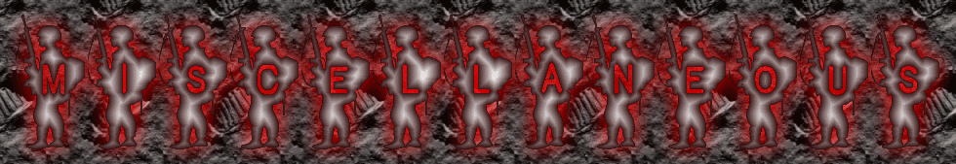

Plane- The plane will fly across the map when there are no supplies on screen, and from that point will drop supplies. The plane will also shoot down zombies while it is on screen. Meant mainly for animation purposes. Provides visual aid of a realistic zombie simulation.
Parachute- The supplies will be attached to these parachutes. The size of the parachute will slowly shrink as the supply eventually reaches the ground and the parachute disappears. Meant entirely for visual appeal.
Bullets- The bullets will be generated and fired from both the turrets on top of bases and from the soldiers guns. These will cause damage to zombies until they are killed. Adds visual appeal as well.
Turrets- The turret is attached to the top of each base. They continue to rotate, and will shoot when zombie is visible (along its angular path).

Slide 6

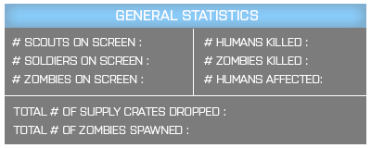
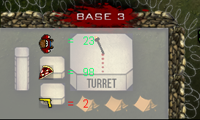
Total Statistics Bar- Keeps track of the statistics about actors currently on screen.
The displayed information includes the number of scouts, zombies, and soldiers on screen, and the number of each that are dead/alive. This also states the number of supply crates dropped and zombies spawned. The bar is located at the top of world, and will be half-transparent until a mouse clicks on it.
Base Statistics Bar- This displays statistics for individual bases. The display information includes the population, food, and weapons inside the base. The statistics bar is set to be invisible and when clicked it is clear to see. The images are on top of each base as seen here.

Slide 7
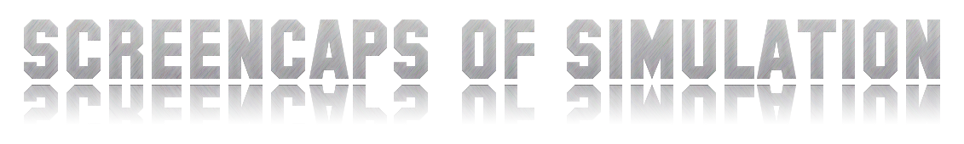
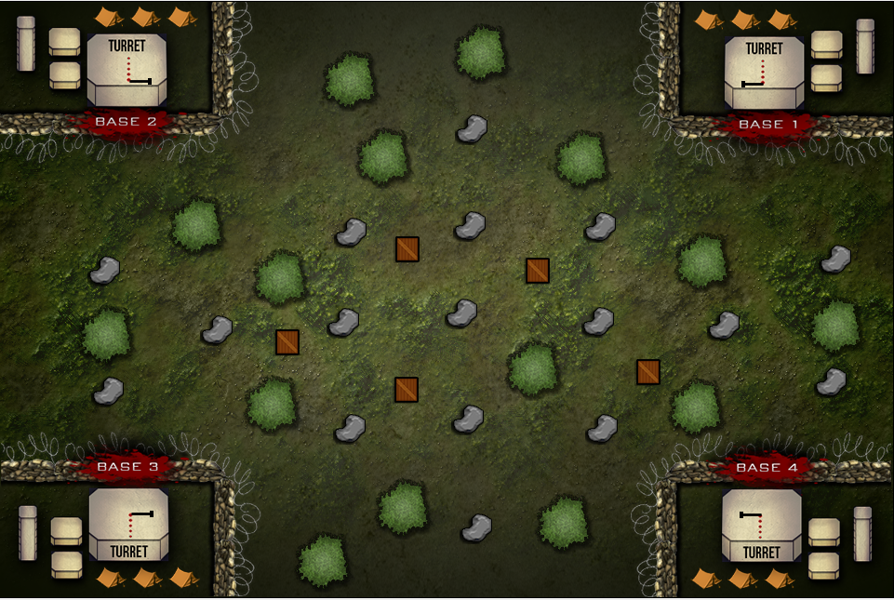
IMAGE OF HOW THE WORLD IS LIKE WITHOUT CHARACTERS OR NON-STRUCTURAL ELEMENTS

Slide 8
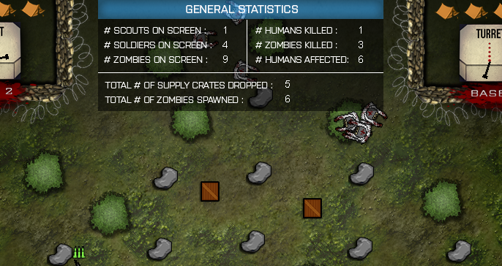
IMAGES OF TOTAL STAT BAR AND BASE STAT BAR, UPDATING INFO ON DEATH/LIVING, POPULATION, SUPPLIES, ETC…

Slide 9
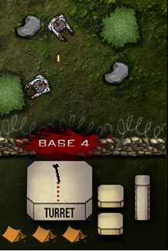
IMAGE OF TURRET ATTEMPTING TO KILL ZOMBIES

Slide 10
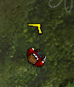
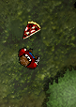
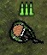
IMAGES OF CHARACTERS WITH ICONS OVER THEIR HEADS

Slide 11
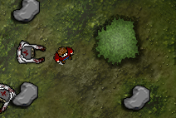
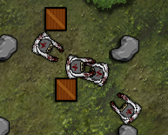
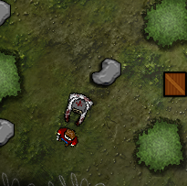
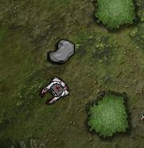
R.I.P
IMAGES OF SCOUTS BEING CONVERTED INTO ZOMBIES, AND OF SCOUTS BEING EATEN

Slide 12
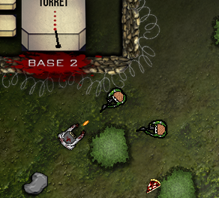
IMAGE OF A SOLDIER ATTACKING A ZOMBIE

Slide 13
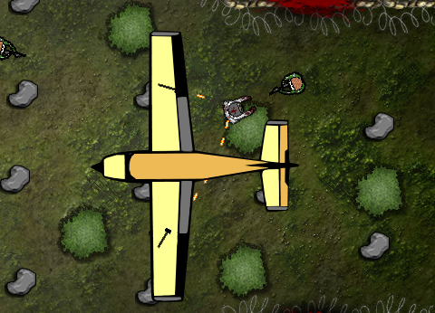
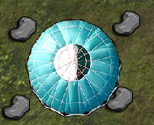
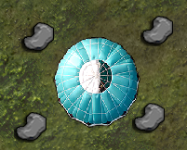
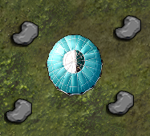
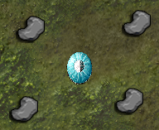
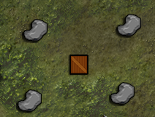
IMAGES OF PLANE FLYING OVER DROPPING A PARACHUTE AND SHOOTING DOWN ZOMBIES

Slide 14
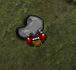
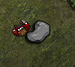
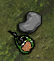
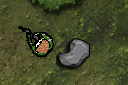
IMAGES OF SCOUTS AND SOLDIERS AVOIDING OBSTACLES

Slide 15
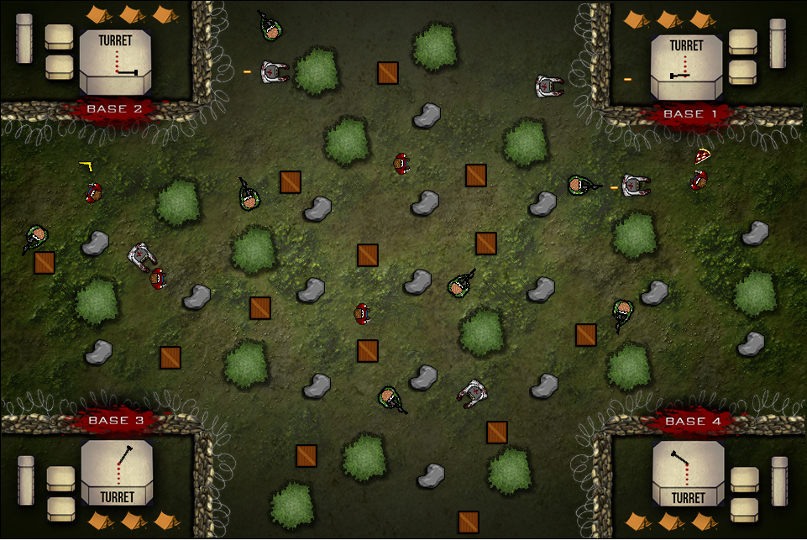
FINAL PRODUCT
All these different elements combine into an extremely interesting simulation; in which “Humans (Scouts and Soldiers)” compete with Zombies until victory or the death of the human race.

Slide 17

Process-
Advantages of OOP:
It helped us to use a clear modular structure during the entire coding procedure.
This allowed us to implement code from a super class multiple times into other subclasses.
Example: character behavior into zombies, soldiers and scouts.
This also allowed us to maintain proper coding conventions such as encapsulation of data in an efficient method through the usage of abstract and protected methods.
OOP also made it easy to modify existing code when creating new classes as they can be created with small differences to existing ones.
OOP provided a good foundation for the code within the simulation so that all programmers could understand code in an efficient manner.
Product-
Advantages of OOP:
In the end the time taken to learn how to efficiently use object oriented programming was virtually nothing in comparison to the time needed if code was done procedurally.\
Overall the product produced was interesting and achieved what the group desired.

Slide 18
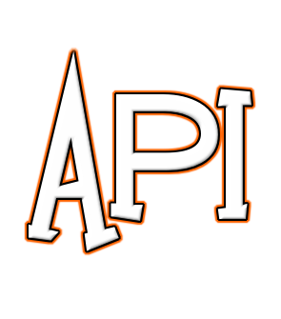
Process-
Advantages of API:
In One sense API’s were great time savers.
They provided each group member clear understanding of what each part of every class did.
This made it so that they could implement parts of any class into all of the others.
Example: Implementing the method to return to base in both a scout and base class.
Also helped with debugging when it was needed.
Disadvantages of API:
Quite time consuming when it is done in a proper fashion.
Could have used more time to increase quality of code than description of it.
Product-
Advantages of API:
In the end the time taken to Implement API was very useful as it helped us understand a necessity in real programming situations.
Overall the product benefited from the use of API No matter how much time it required.

Slide 19
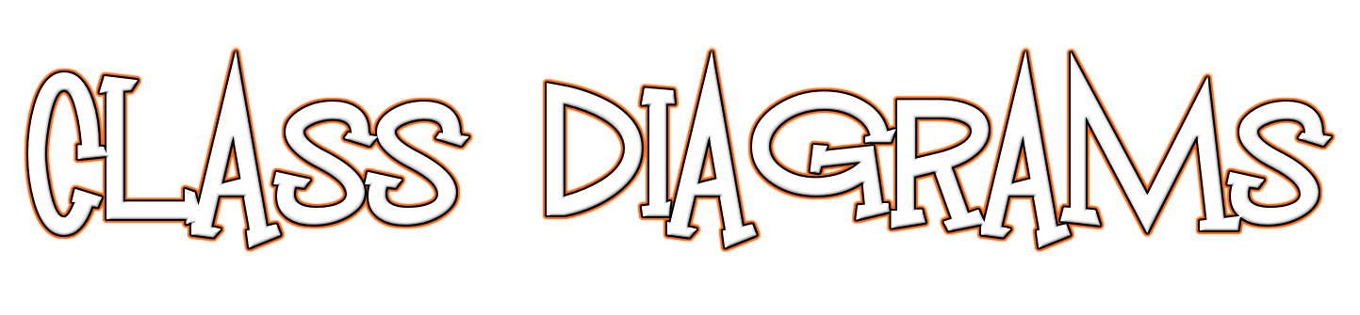
Process-
Advantages of Class Diagrams:
It helped us as a group to think outside of the box in relation to our classes, so we could consider the links between all classes, and everything we wanted to implement in our simulation.
It was a useful blueprint to follow for creating our classes in a structured manner.
Definitely helped to analyze all of the interaction before writing code.
Disadvantages of Class Diagrams:
Requred time to solidify ideas before actually writing code
Took away from productive work time as certain ideas were not implemented.
Product-
Advantages of Class Diagrams:
In the end the time taken to create class diagrams was very useful as it helped us understand a necessity in real programming situations as well as manage our code in an effective and well thought out manner.
Overall the product benefited from the use of class diagrams despite the fact that they required a fair amount time to create.

